Slide 1
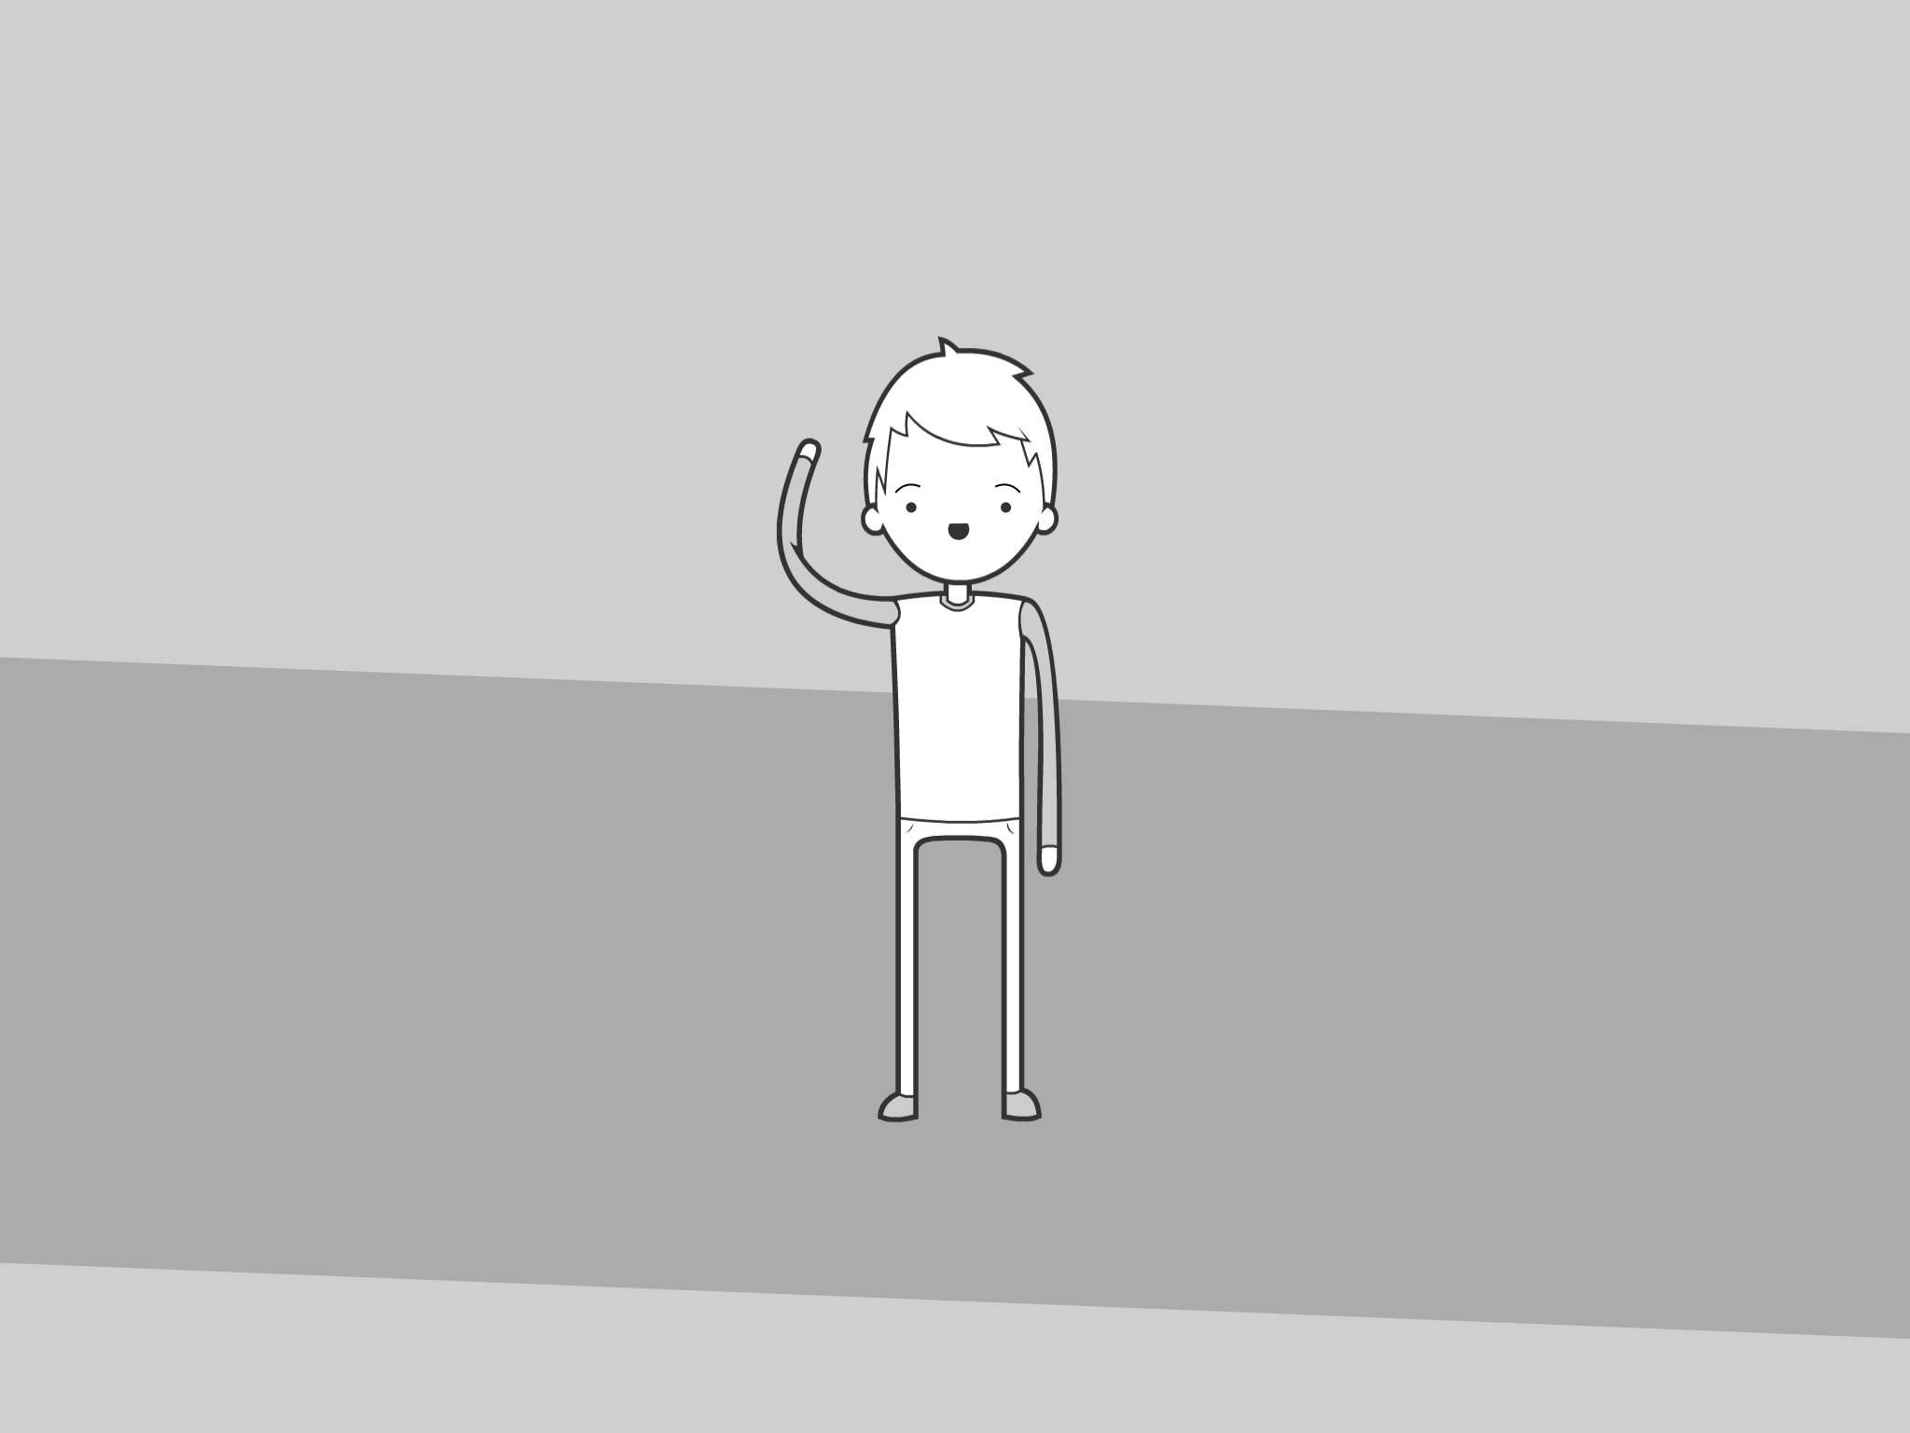
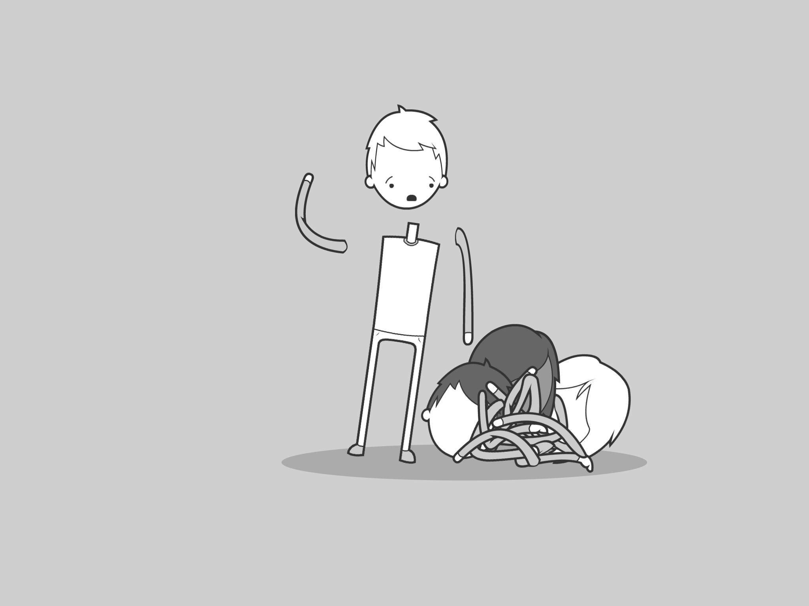
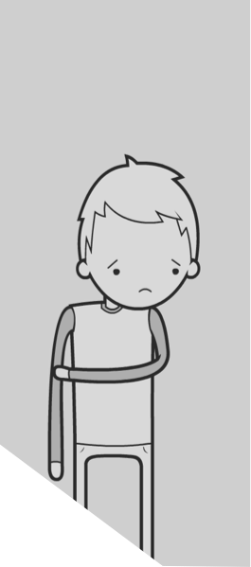
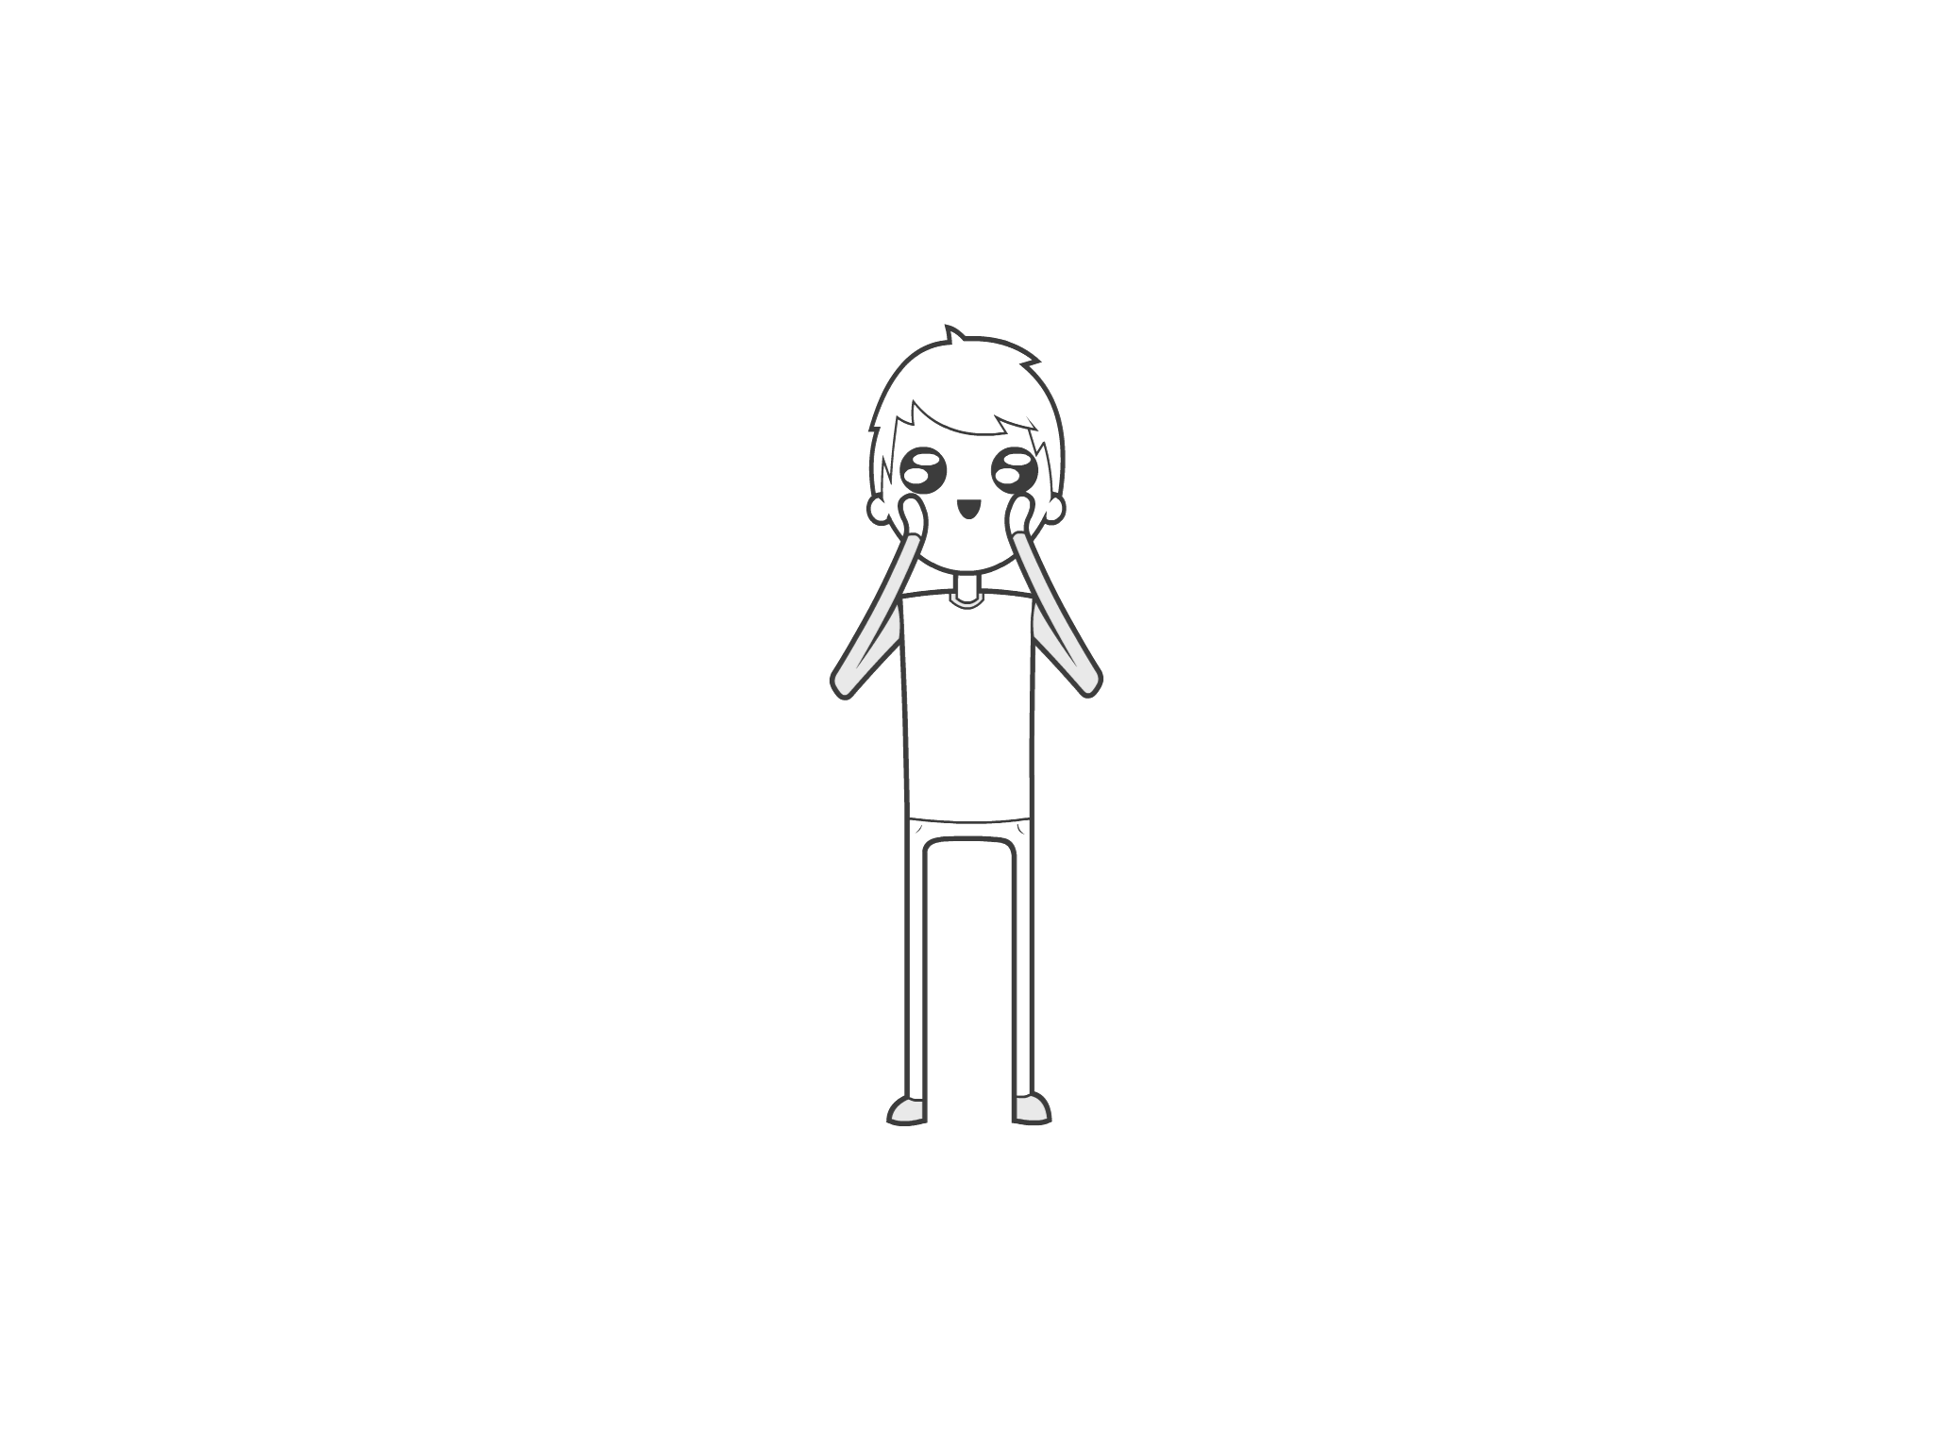
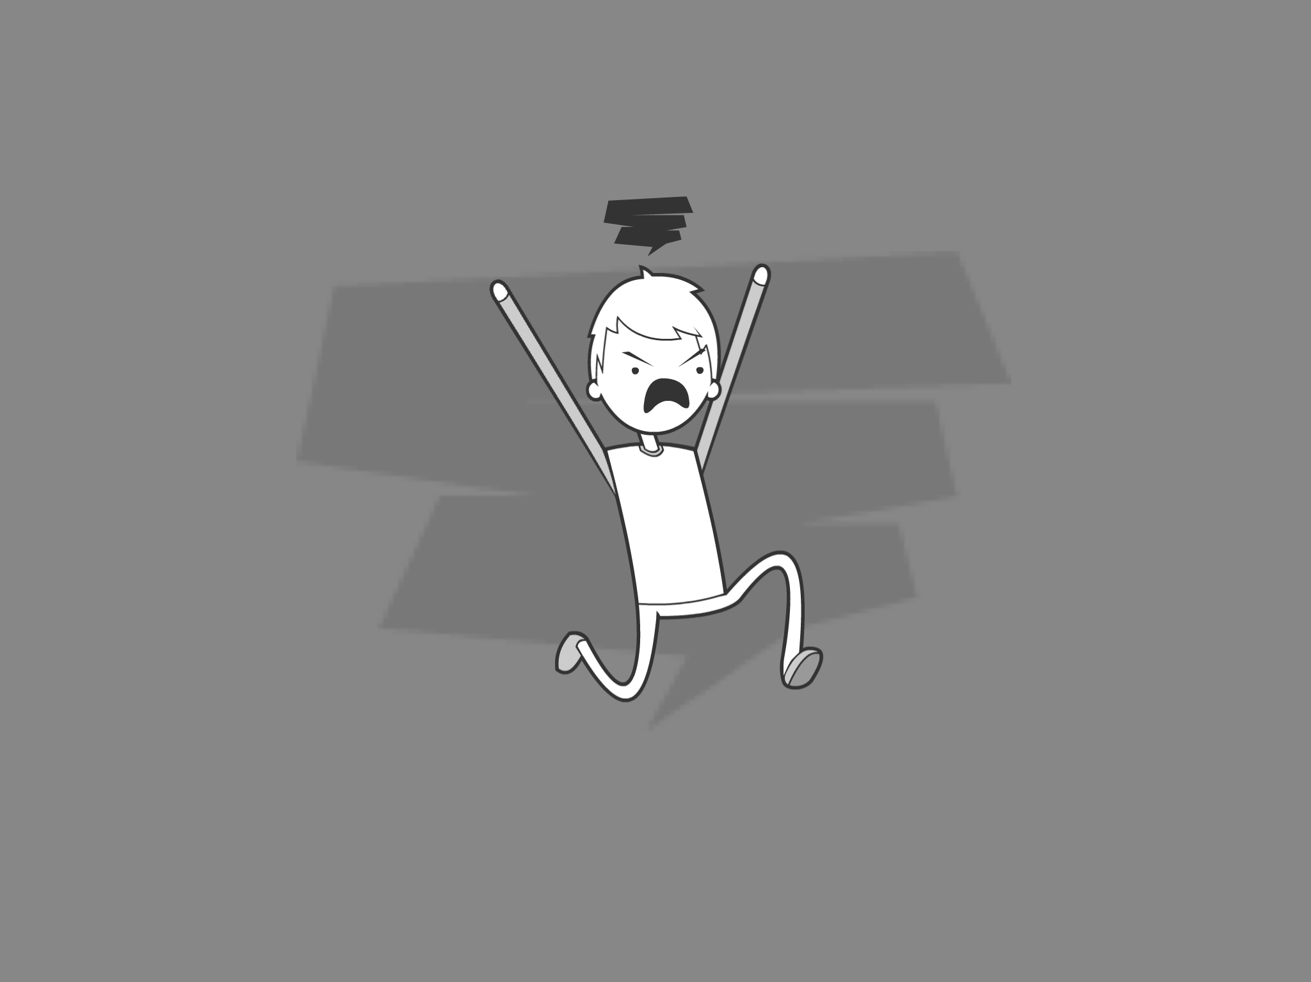
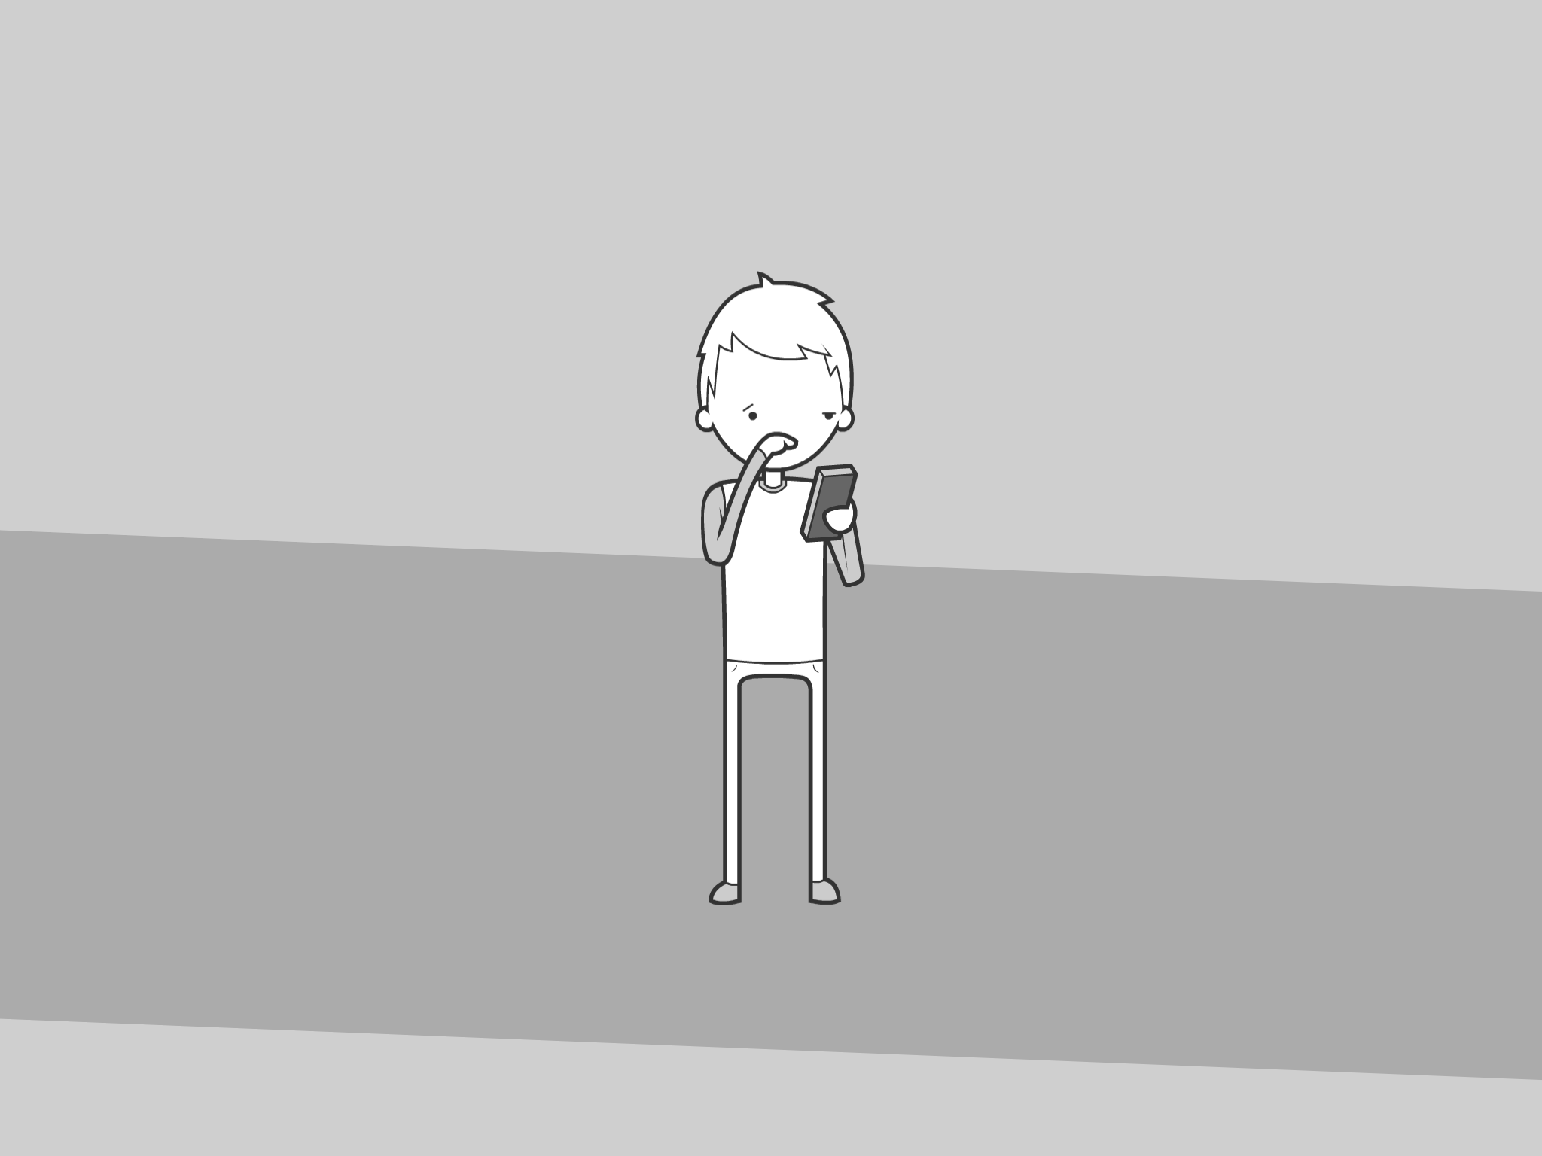
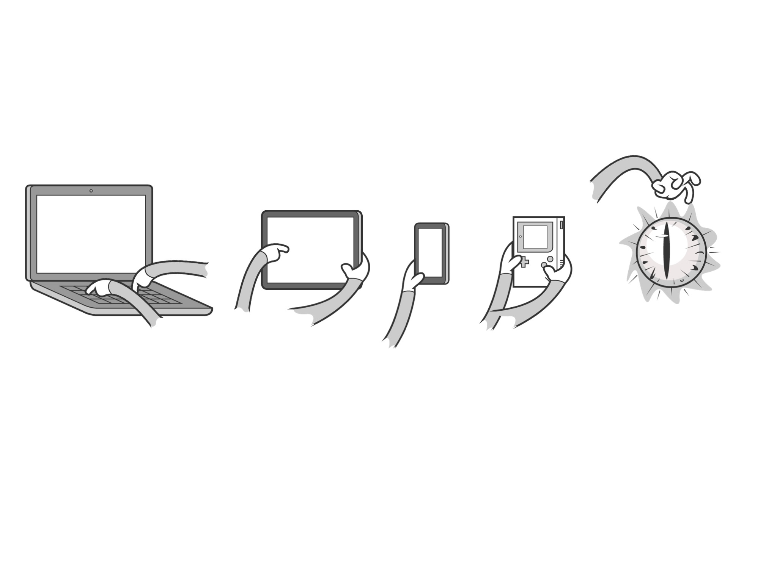
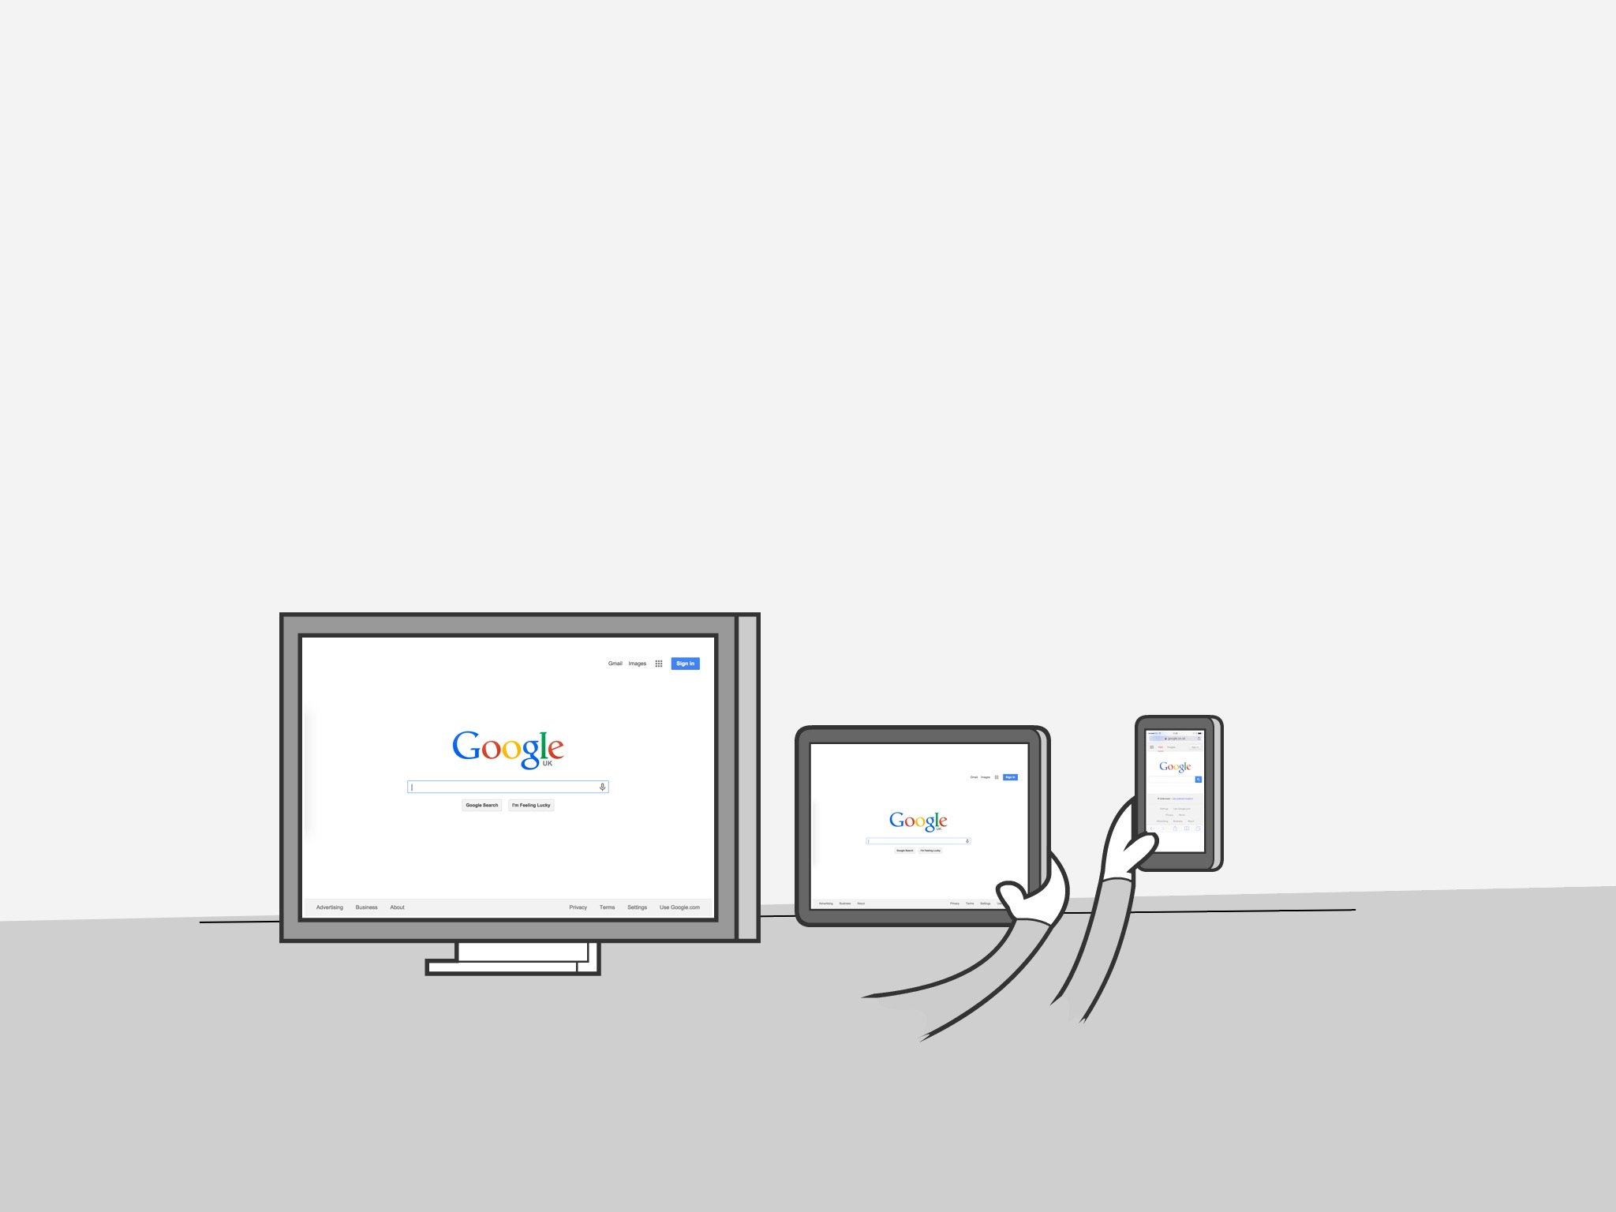
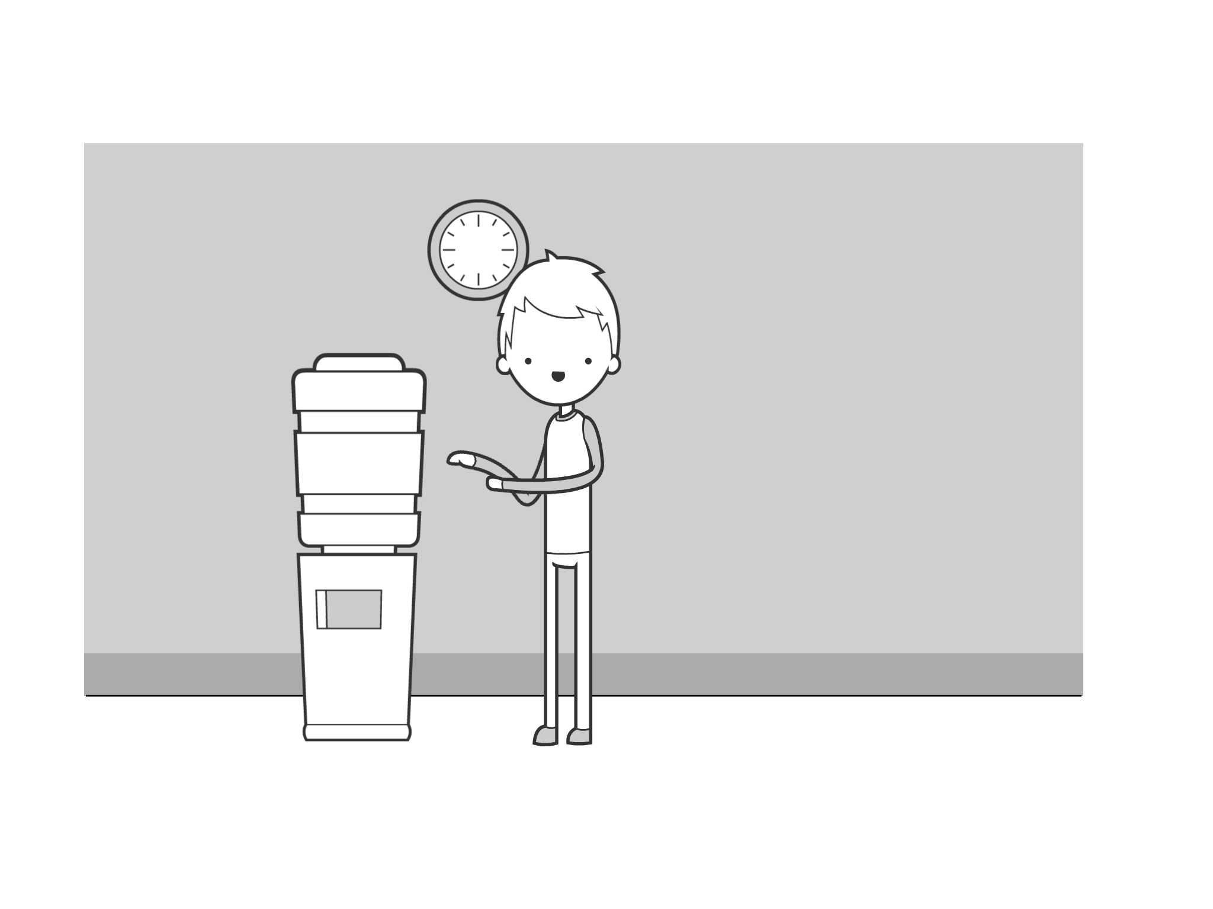
UX
comic library
for example…
and wage rage
It’s basically just a bunch of body parts. Which is kind of gross.
Worry
wonderment
Hi
Want to tell a user story with a UX comic?
Don’t want to draw?
then you can use this comic element library instead!
You can use these body parts to create a variety of emotions,
This is a UX comic, so we will probably need some devices for your characters to use…
Luckily we’ve got a bunch of typical user devices!
TAP
Swipe
TAP
Swipe
Laptop
Tablet
Smartphone
Gameboy
Seeing stone
What’s cool is that all the screens are squared off
so it’s dead easy to add screenshots, sketches or wireframes onto them.
You’l probably want to put your character in a location.
There are some elements for that too.
Remember, you don’t need much to add context.
A wall clock and a water cooler means I’m in an office.

Slide 2
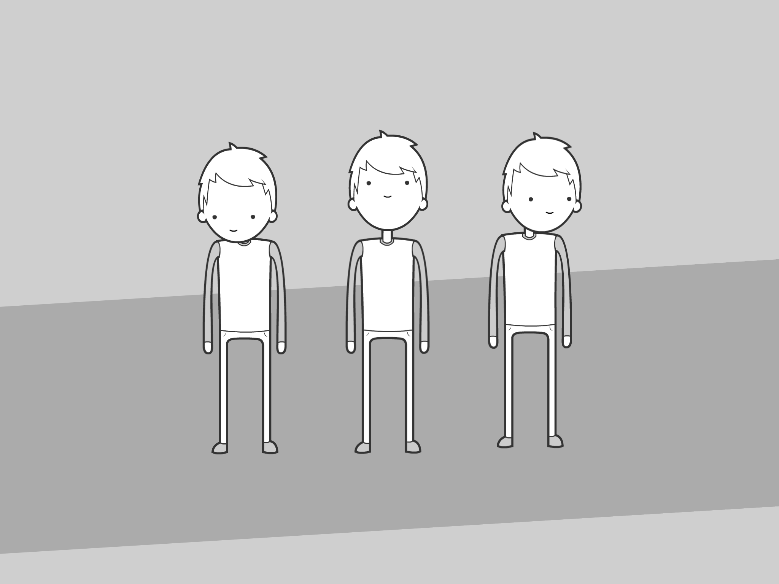
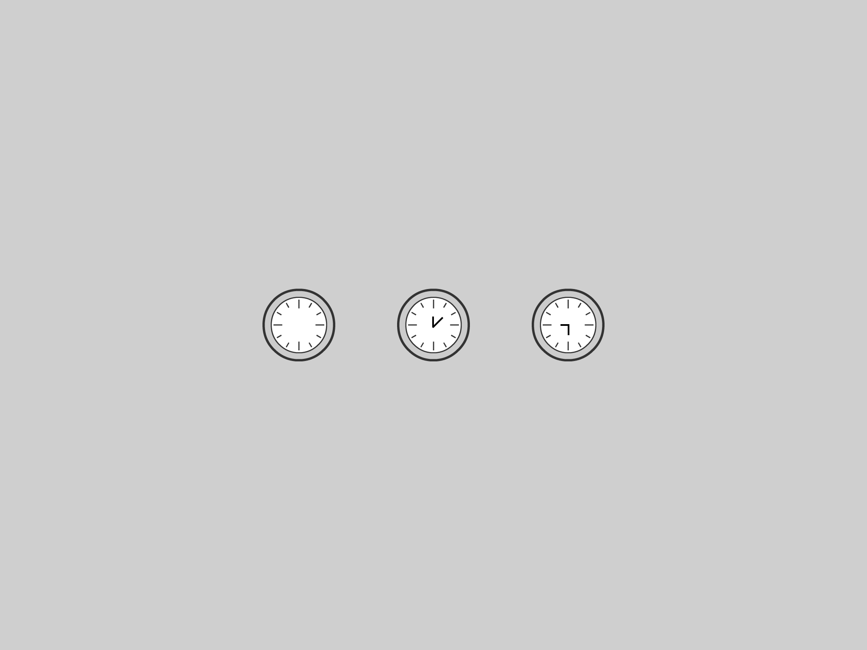
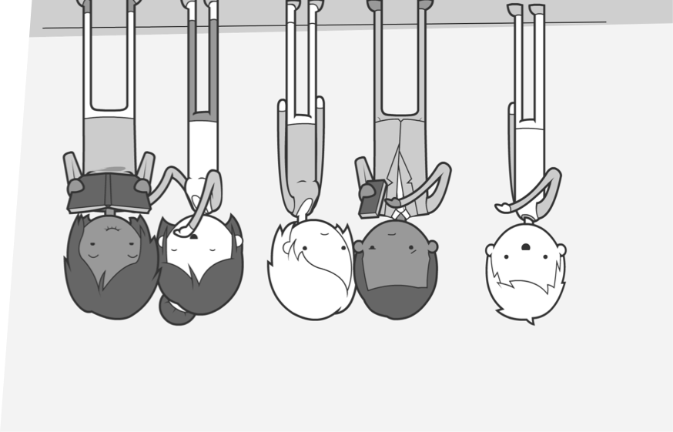
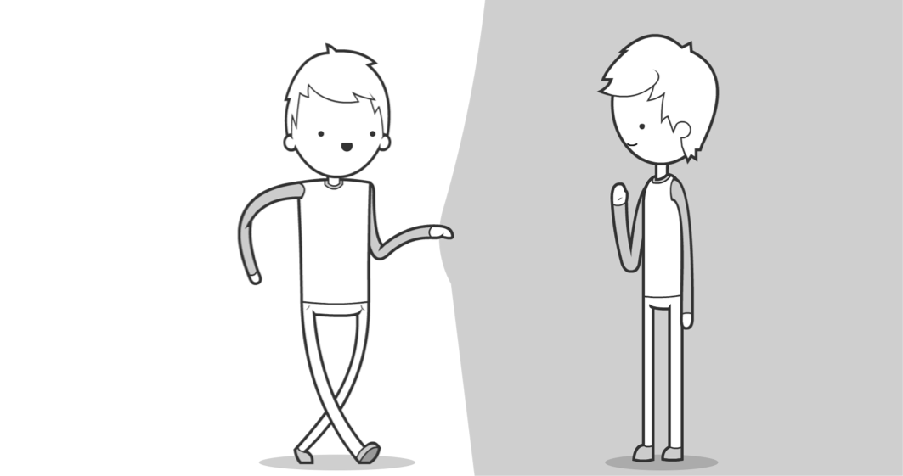
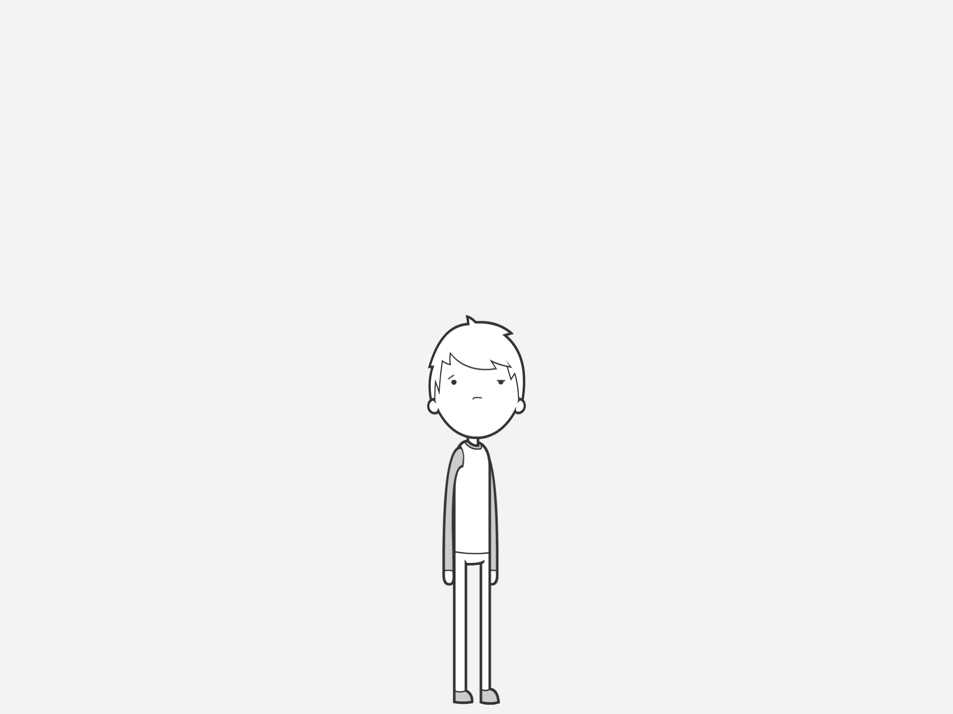
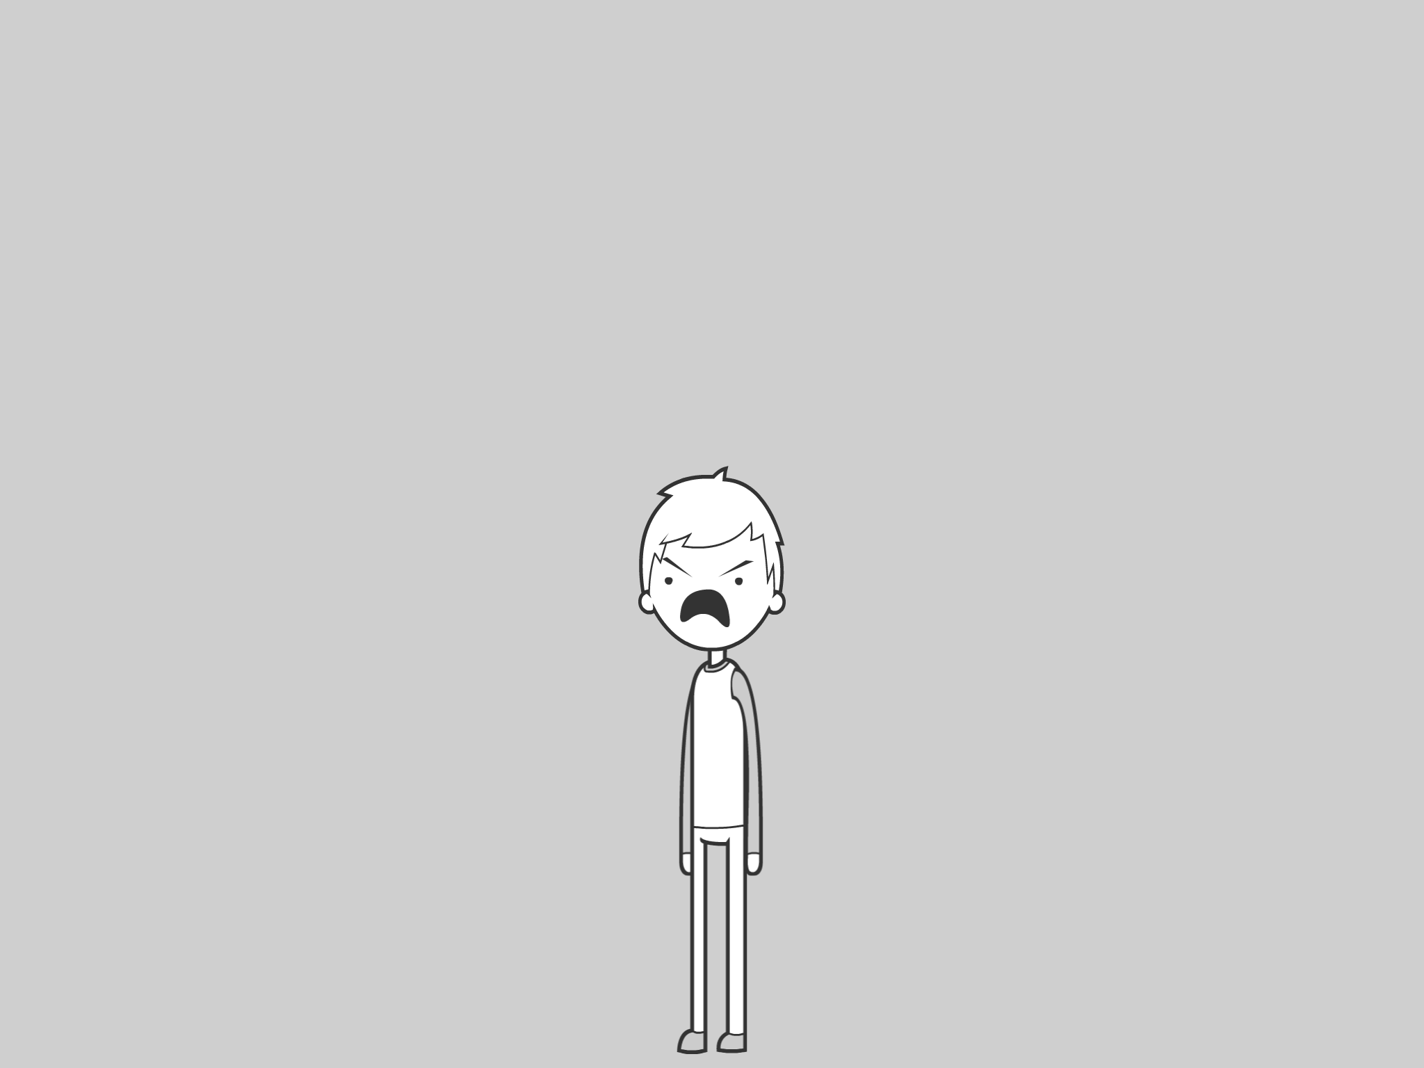
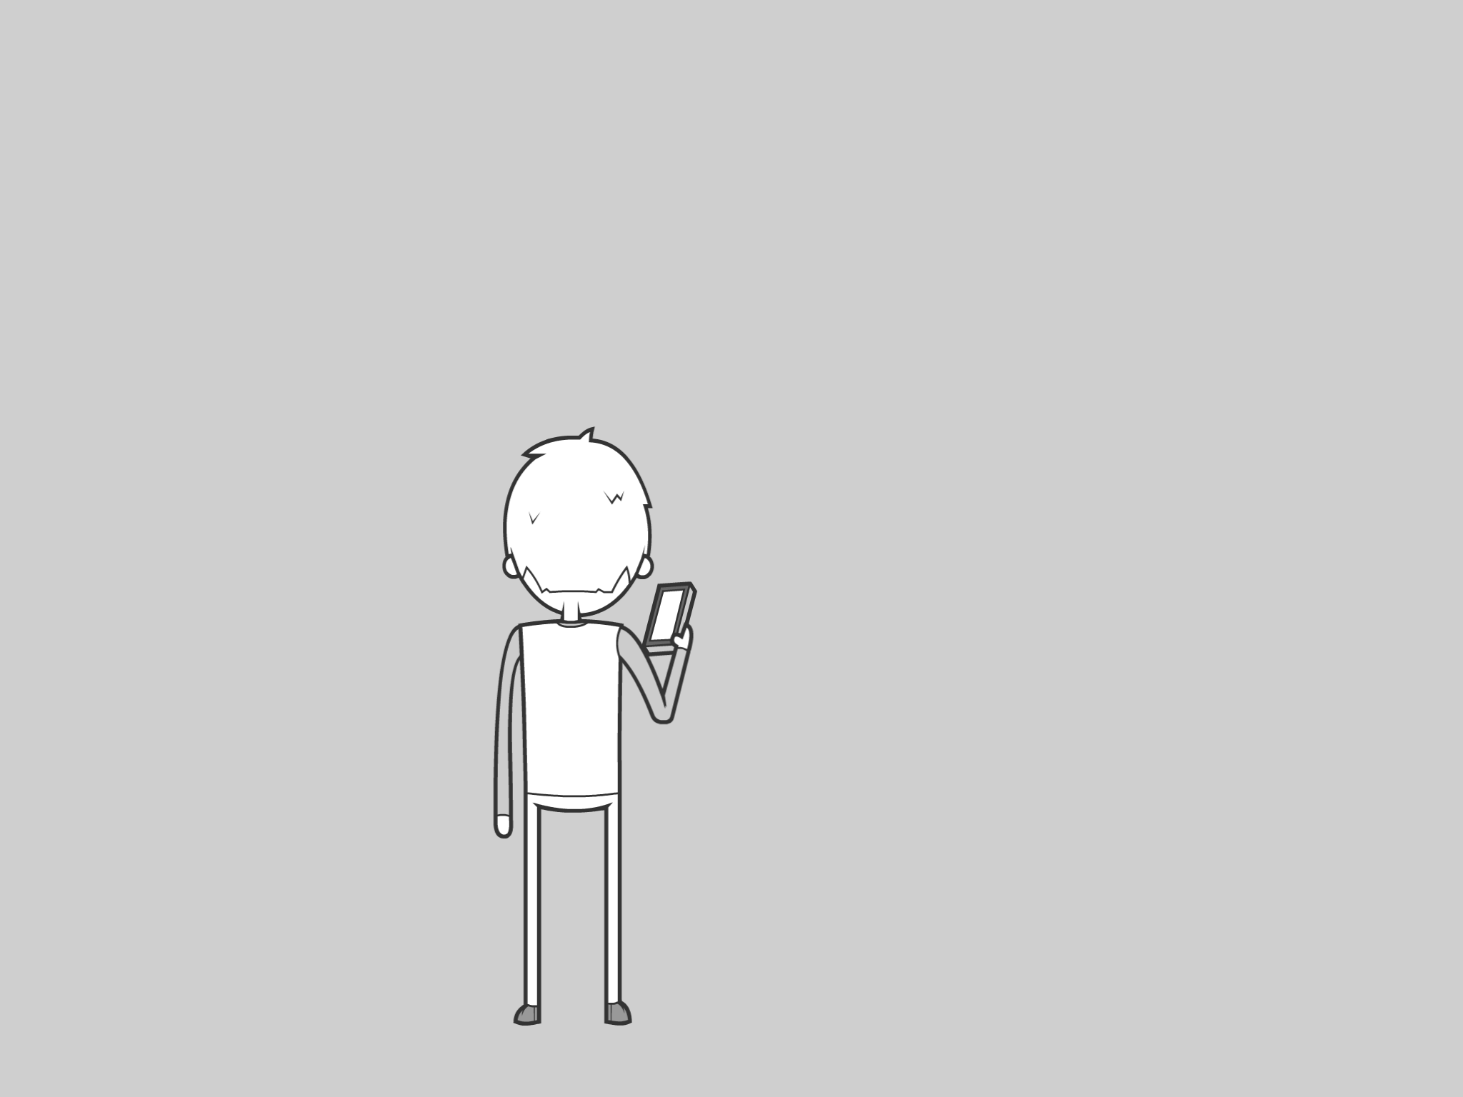
You can reposition the head and face elements
to make your character looK
in different directions
There is a blank clock. This allows you to add your own hands to give you image a sense of time
It makes the different panels on the page easier to distinguish too
You’ll probably need a couple of characters within a user story
Make sure you use characters that are visually different enough to avoid confusing the reader
Consider your background colour.
A darker background could help your character stand out
Cloud bubbles for thoughts…
and square bubbles for electronics and stuff.
There are different types of speech bubble to show how the character is talking.
JAGGY
BUBBLES FOR
SHOUTING!!
Siri, say something
You are not the boss of me

Slide 3
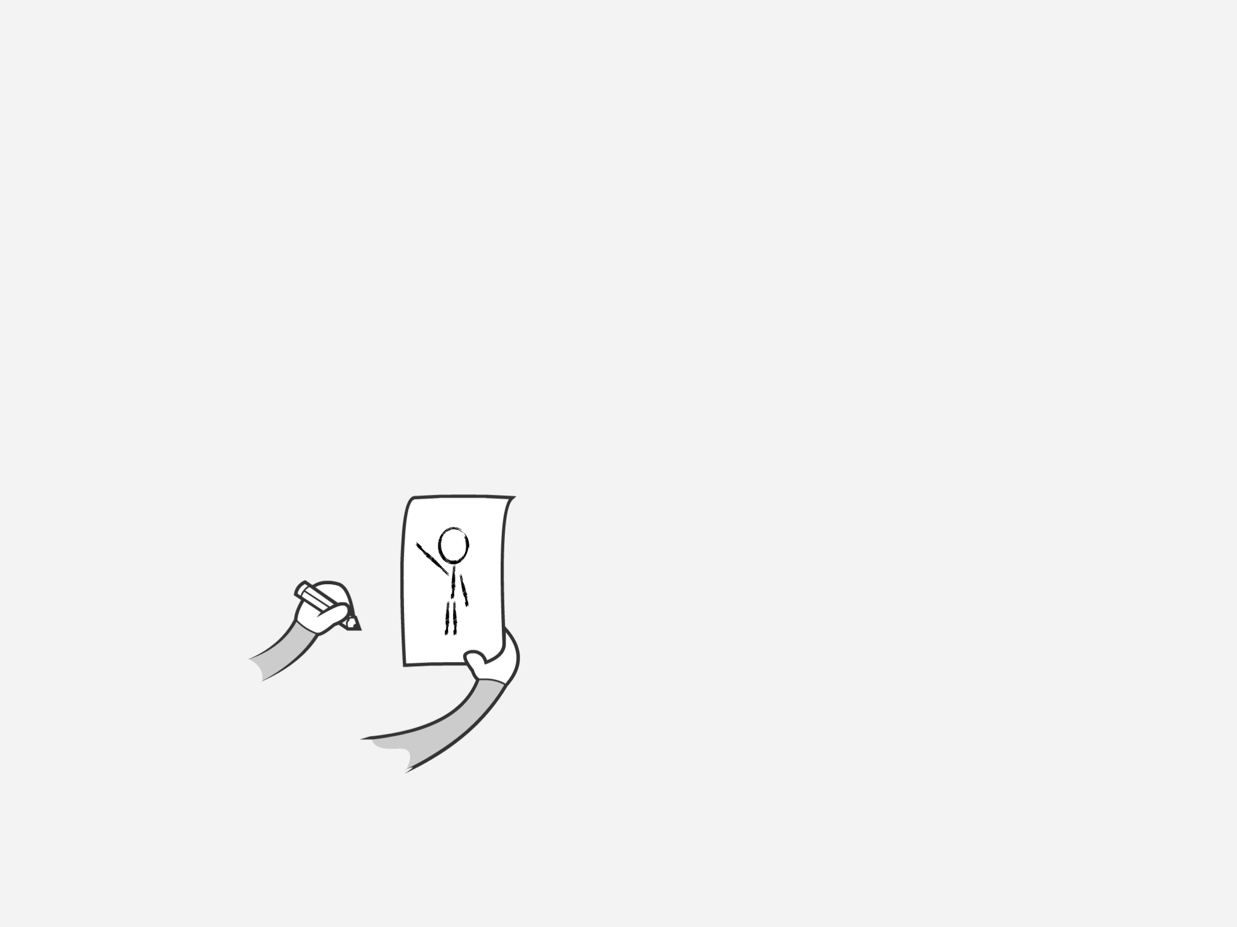
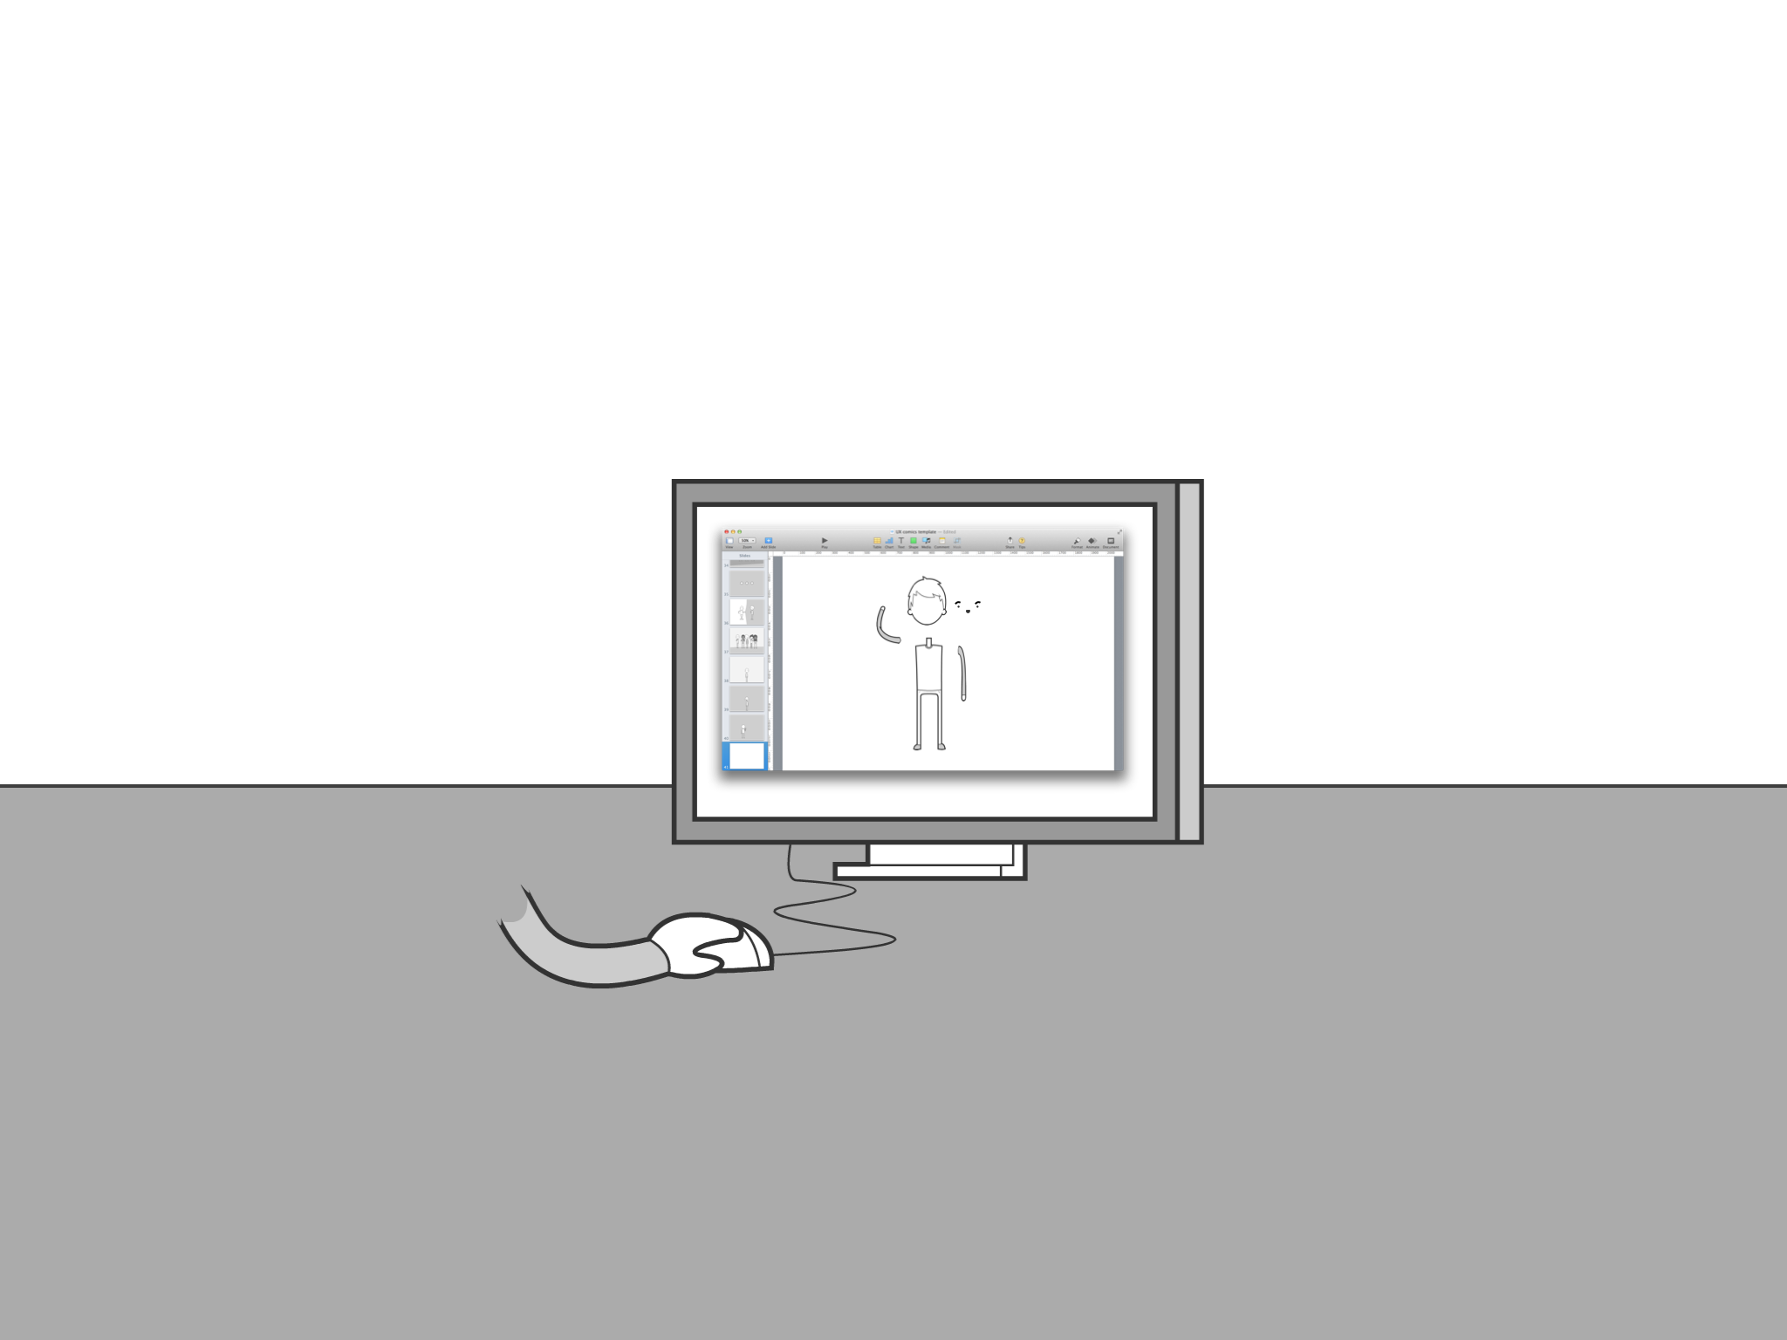
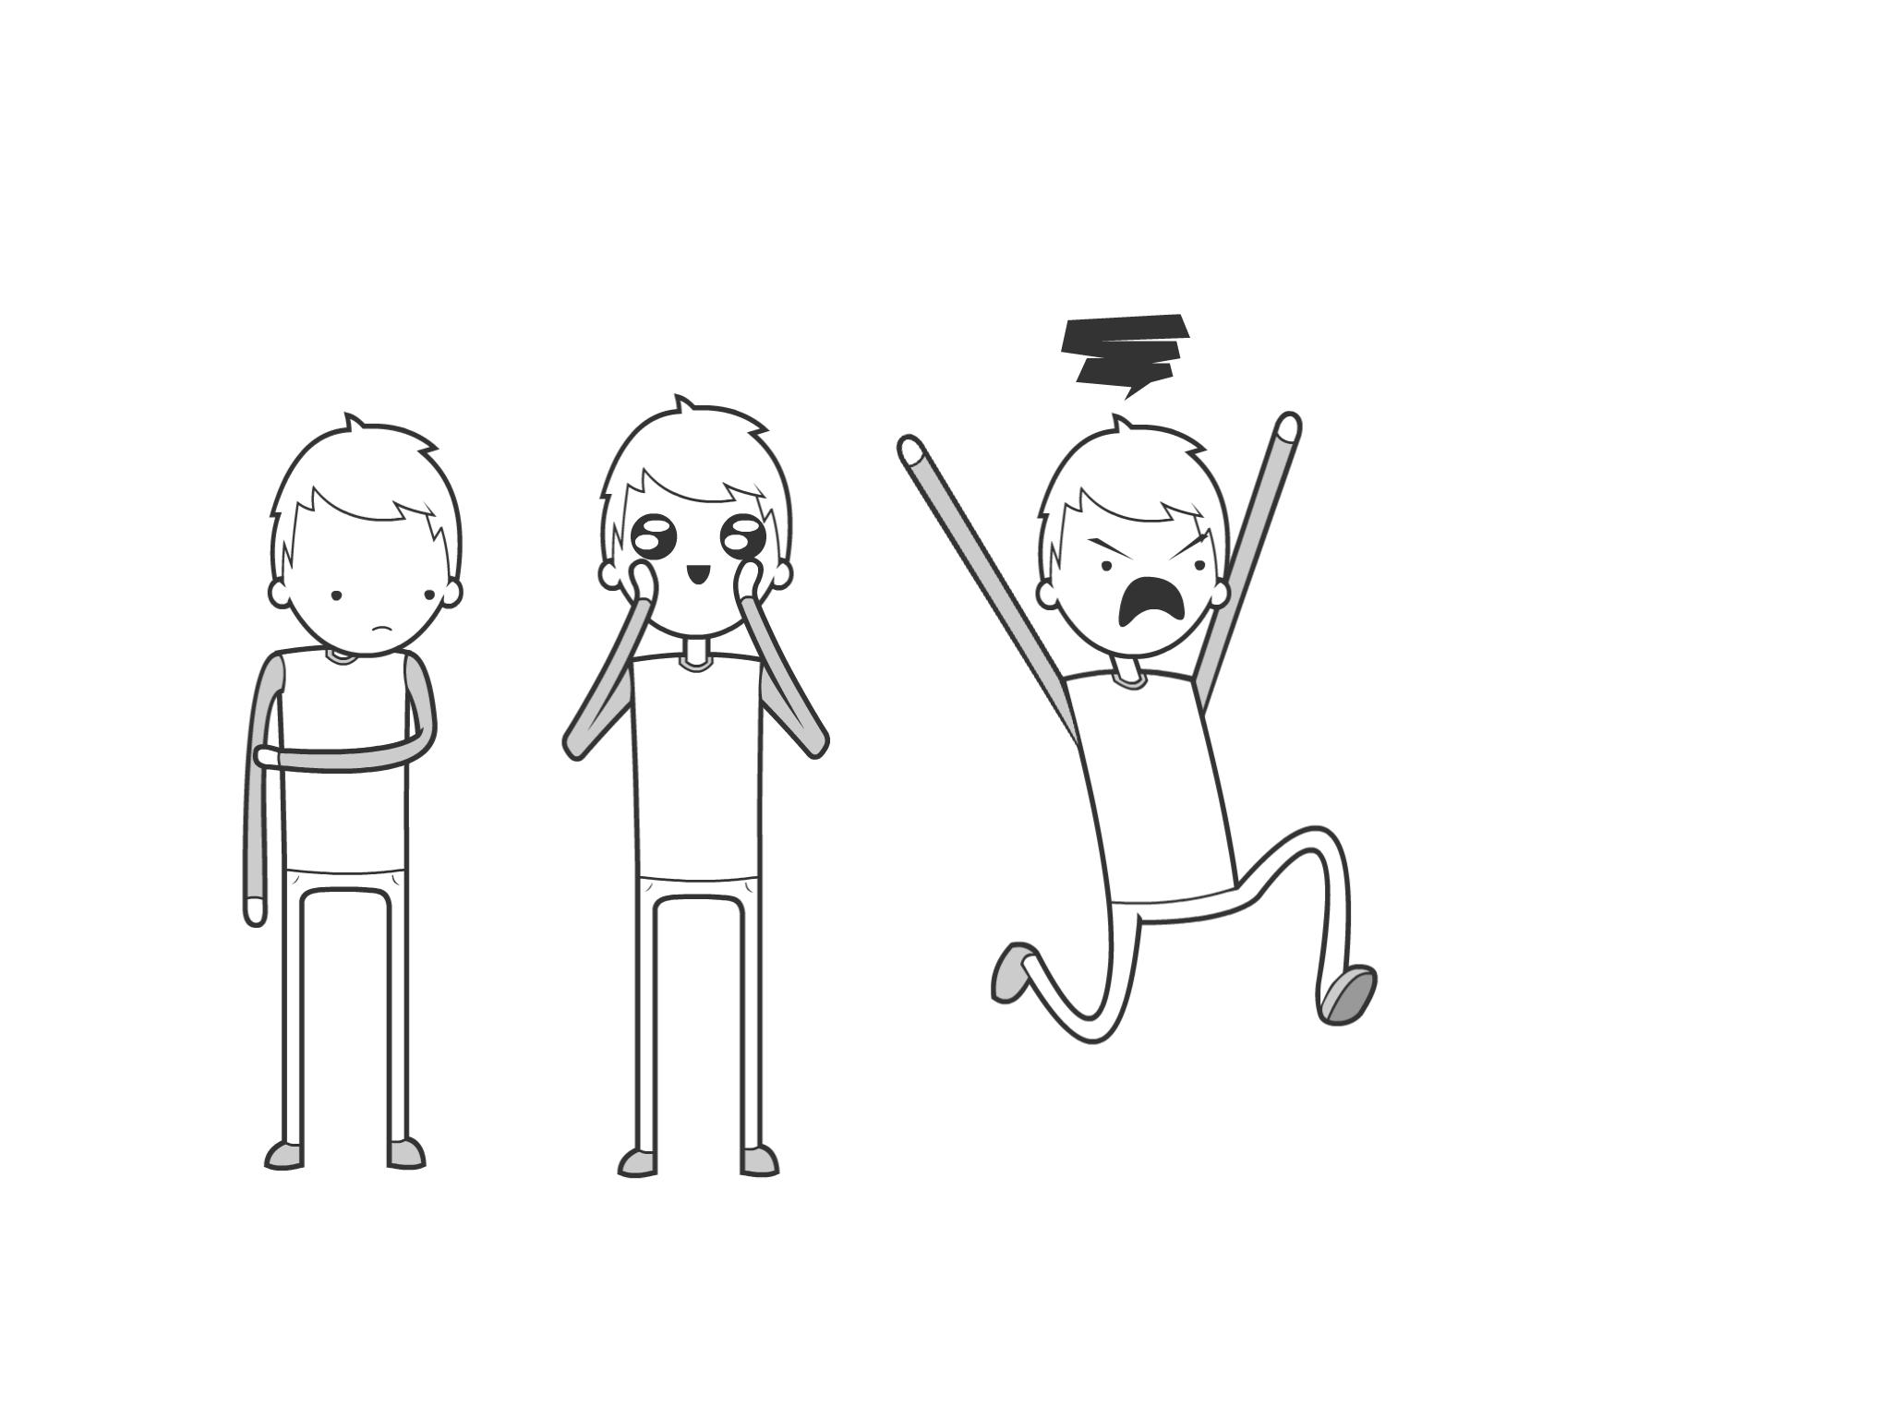
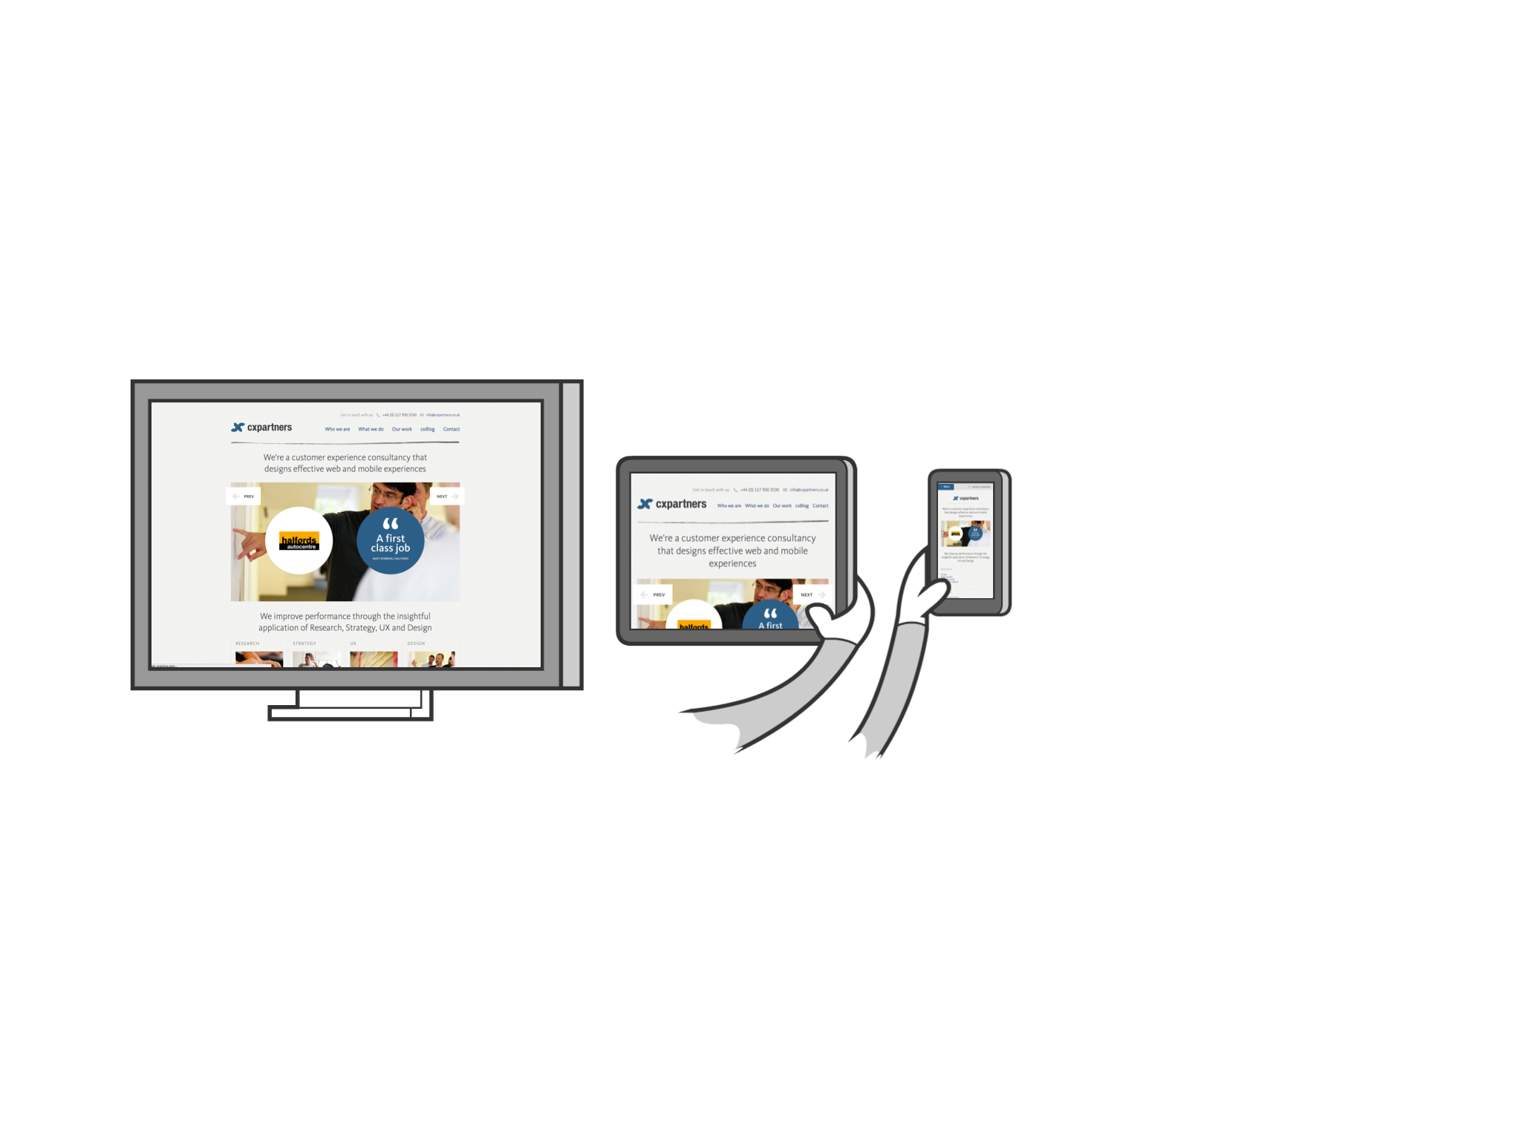
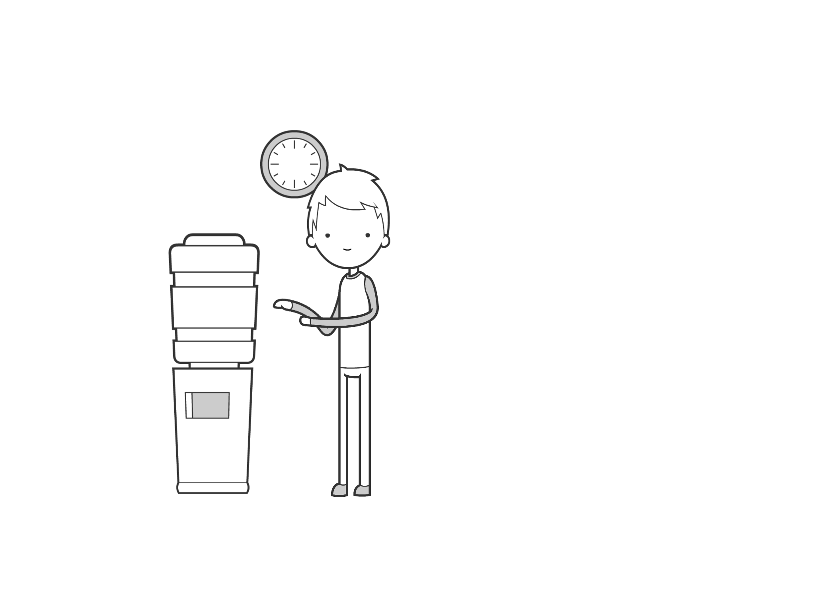
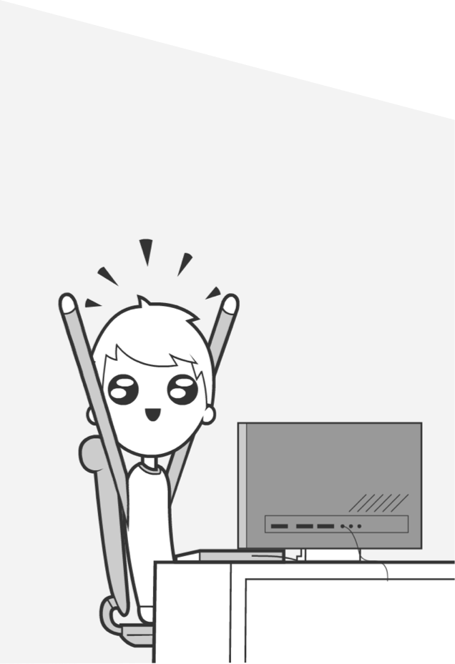
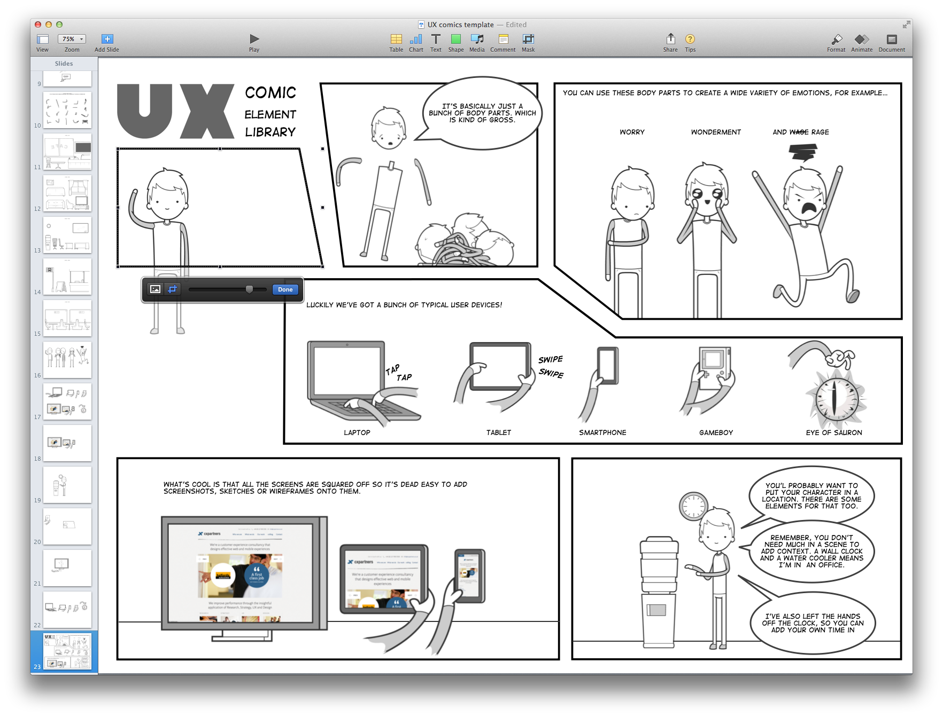
To put a comic together, it’s best to start by sketching out your story
export all your keynote slides as separate images…
Once you’ve planned your images, Create an individual slide for each one
Then bring the images back into keynote (or Comic life) to crop, mask, position, add outlines and speech bubbles.
All the individual elements you’ll need are on the following slides.
Right at the back of the deck are examples of the scenes put together to create this very comic.
I might add to the library as time goes on depending on how useful it is.
So there you have it, pretty much everything you’ll need to create simple UX comics.
Go forth an explain stuff with pictures!

Slide 4
Element library

Slide 5




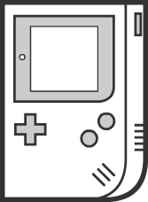




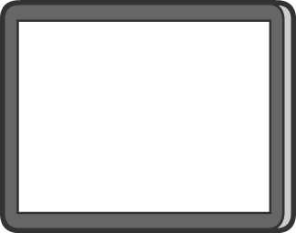

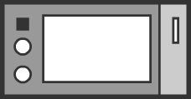

Devices close up

Slide 6
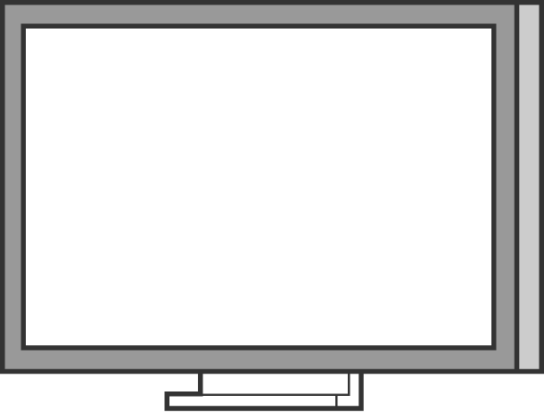
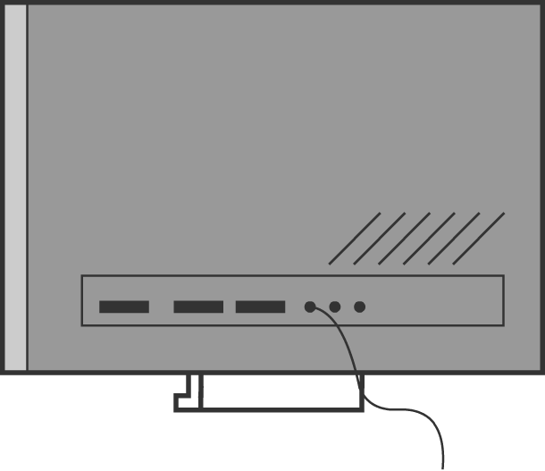






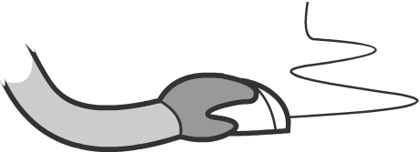




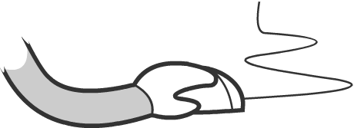
Devices cont & Hands close up (For holding devices)

Slide 7




































Arms and small devices
I’ve not done left/right versions for each arm. just flip horizontally to use one on a different side

Slide 8
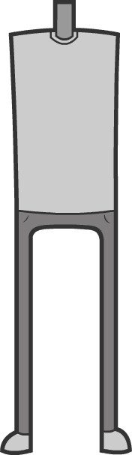

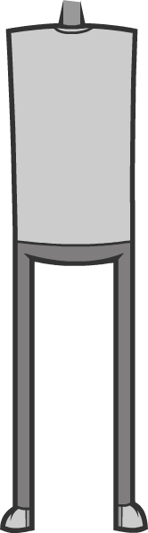


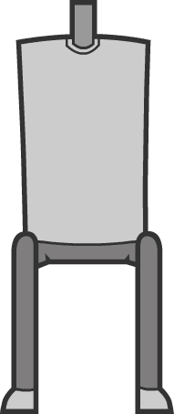
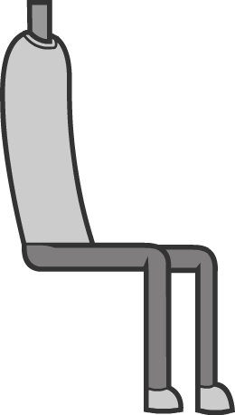
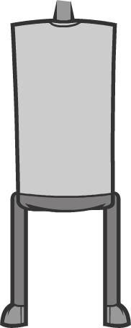
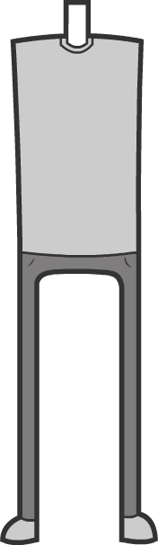

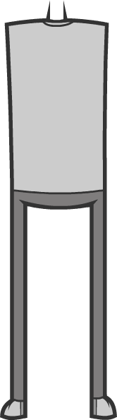

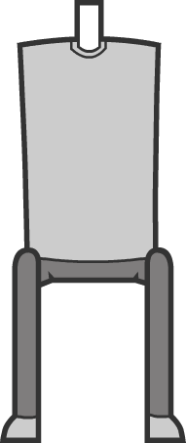
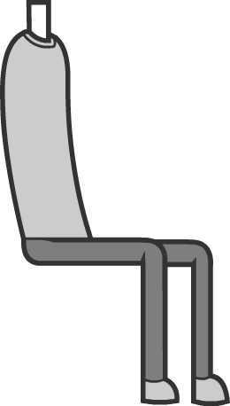
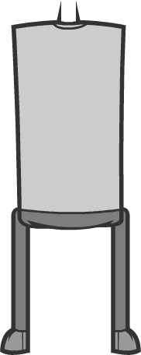

Bodies

Slide 9
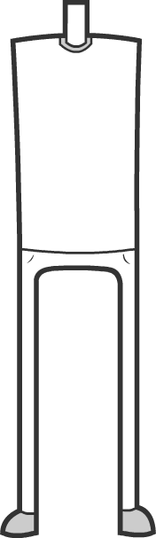

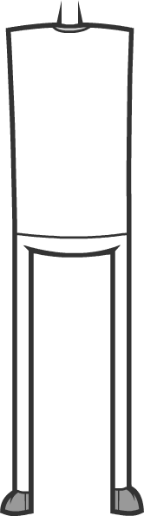

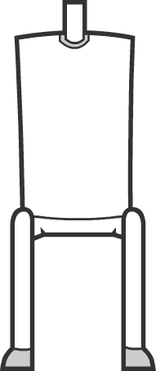
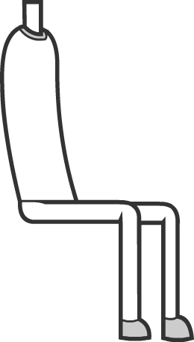
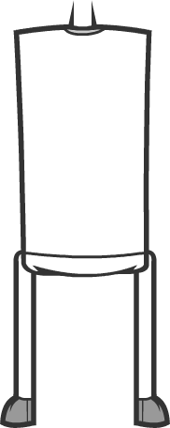

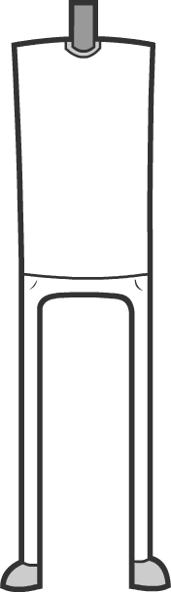

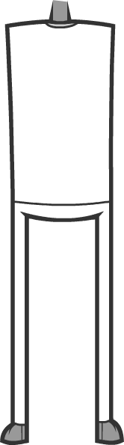




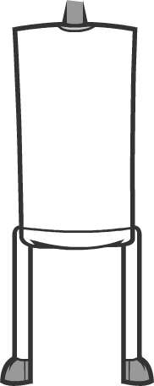
Bodies

Slide 10
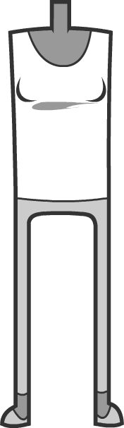

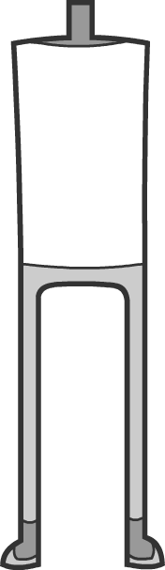













Bodies

Slide 11
















Bodies

Slide 12
















Bodies

Slide 13














Heads

Slide 14

















Heads

Slide 15



















Faces, accessories and emoticons

Slide 16
Speech bubbles
Speech bubble
LOUD NOISES!
thought bubble
Speech bubble for computers robots etc

Slide 17






Places - cafe

Slide 18






Places - home

Slide 19







Places - office

Slide 20



Places - street

Slide 21




Places - train

Slide 22
Example scenes

Slide 25



